Slide 1
Lecture 05 Prototyping & Digital Circuits
CE346 – Microprocessor System Design
Branden Ghena – Fall 2022
Some slides borrowed from: Josiah Hester (Northwestern), Prabal Dutta (UC Berkeley)

Slide 2
Administrivia
Labs
Debrief: How did that go?
Can use personal computers if preferred
See schedule of Lab hours available on Canvas for checkoffs
Due by end-of-day Thursday
Also due are postlab questions (on Canvas)
Quiz
Today at end of class!
Someone remind me at ~4:30 if I don’t stop

Slide 3
Project Proposals
It is time to start forming teams and working on Proposals
Due next week Thursday! (10/13)
Project details are posted to Campuswire
Specific proposal details are on the Canvas assignment
1-2 pages, with some specific items you MUST include
Project teams are 2-3 students (4 under rare occasions)
You may NOT work alone
There is a partnership survey if you want us to match you with someone
Due by end-of-day Sunday

Slide 4
Today’s Goals
Explore another peripheral interaction pattern: DMA
Discuss prototyping methods and basic circuits components
Understand the basics of digital circuitry
Enough to be able to interact with the Microbit

Slide 5
Outline
DMA
Prototyping
Digital Circuits
Components

Slide 6
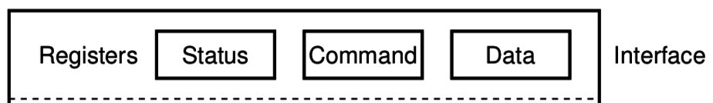
Reminder: Polling I/O
while STATUS==BUSY; Wait
(Need to make sure device is ready for a command)
Write value(s) to DATA
Write command(s) to COMMAND
while STATUS==BUSY; Wait
(Need to make sure device has completed the request)
Read value(s) from Data
This is the “polling” model of I/O.
“Poll” the peripheral in software repeatedly to see if it’s ready yet.

Slide 7
Reminder: Interrupts, visually
Some code that’s executing
Interrupt triggers!
Interrupt handler code
Continue original code

Slide 8
Direct Memory Access (DMA)
Even with interrupts, providing data to the peripheral is time consuming
Need to be interrupted every byte, to copy the next byte over
DMA is an alternative method that uses hardware to do the memory transfers for the processor
Software writes address of the data and the size to the peripheral
Peripheral reads data directly from memory
Processor can go do other things while read/write is occurring

Slide 9
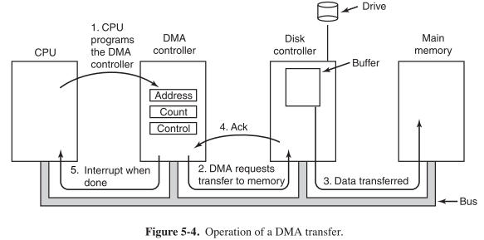
General-purpose DMA

Slide 10
Full peripheral interaction pattern
Configure the peripheral
Enable peripheral interrupts
Set up peripheral DMA transfer
Start peripheral
Continue on to other code
Interrupt occurs, signaling DMA transfer complete
Set up next DMA transfer
Continue on to other code, and repeat

Slide 11
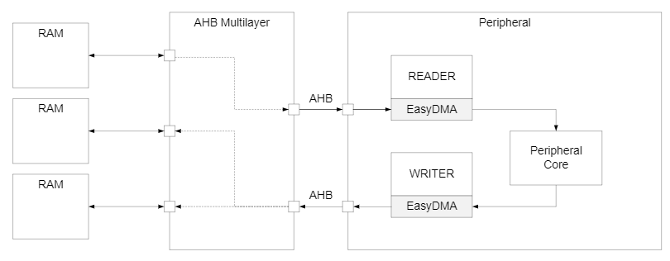
Special-purpose DMA
nRF52 uses “EasyDMA”, which is built into individual peripherals
Only capable of transferring data in/out of that peripheral
Easier to set up and use in practice
Only available on some peripherals though (no DMA for TEMP)
Warning: addresses for DMA buffer MUST be in RAM!

Slide 12
Break + Open Question
What kinds of peripherals/devices should you use the DMA for?

Slide 13
Break + Open Question
What kinds of peripherals/devices should you use the DMA for?
Anything where there is a lot of data coming in over a period of time
Either a big buffer of lots of data, like a radio message
Or a bunch of individual samples, coming in quickly
Devices
Messages to/from other devices (radios, wired busses)
Sensor readings (if read quickly)
Canonical example from general computing: disks (HDD/SSD)

Slide 14
Outline
DMA
Prototyping
Digital Circuits
Components

Slide 15
Prototyping goals
Does this thing work at all?
Particular IC
Circuit layout
Software design
etc.
Sometimes before doing something more serious with it
Design a PCB, Make a product, etc.
Not uncommon that the prototype is as far as you’ll get

Slide 16
Isolating tests
The goal when prototyping is to isolate the question at hand
Do consider
New sensor/IC/component/whatever
Do not consider
Power
Interference
Enclosure
Stable microcontroller
Soldering skills

Slide 17
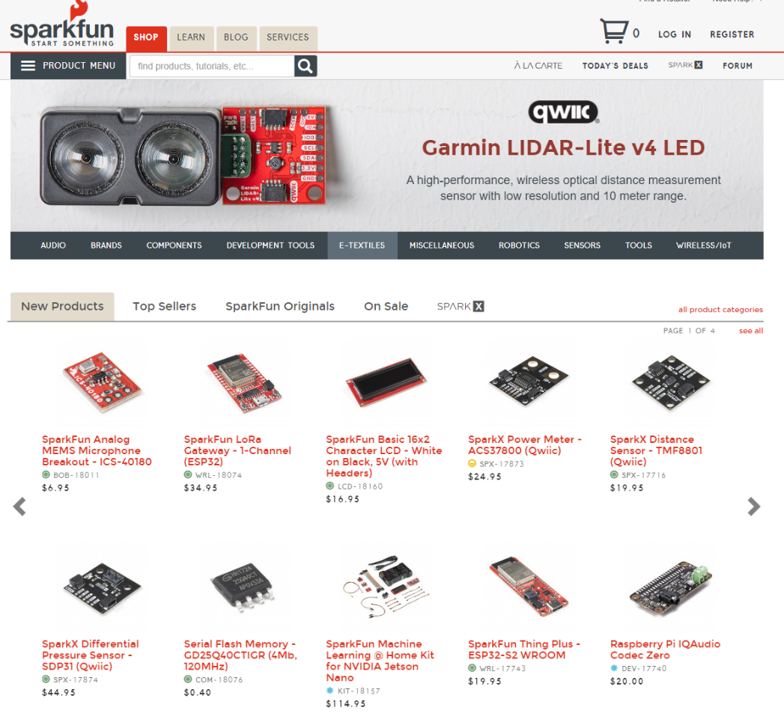
Buying Parts
Prototyping vendors
Where you look for cool stuff to buy
Sparkfun
Adafruit
Electronics vendors
Where you buy parts when you know what you need
Digikey
Mouser

Slide 18
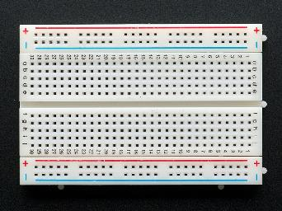
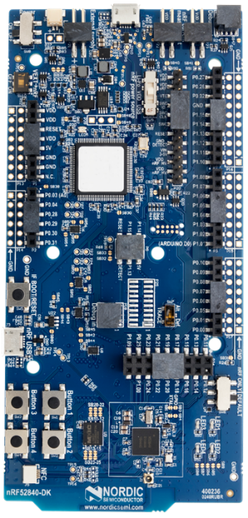
Prototyping methods
Breadboarding
Plug and connect components as needed
Build up arbitrarily complex designs from nothing
Development kits
Pre-fabricated systems design for testing components
Small-scale test PCBs
Design a PCB that demonstrates the thing you’re interested in
Making a PCB is less hard than some might think (Eagle, Fritzing, etc.)
$20-30 for small, low-speed PCBs from batch services like OSHPark

Slide 19
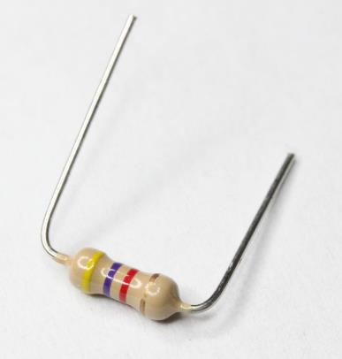
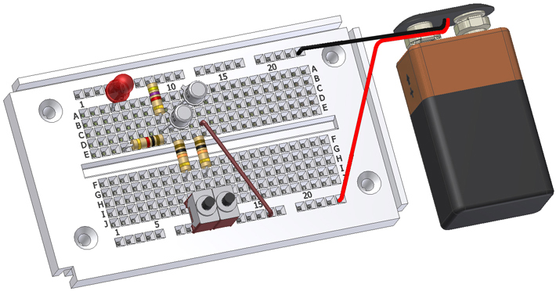
Breadboards for prototyping
Reusable platform for temporary circuits
Plug in jumper wires and through-hold components

Slide 20
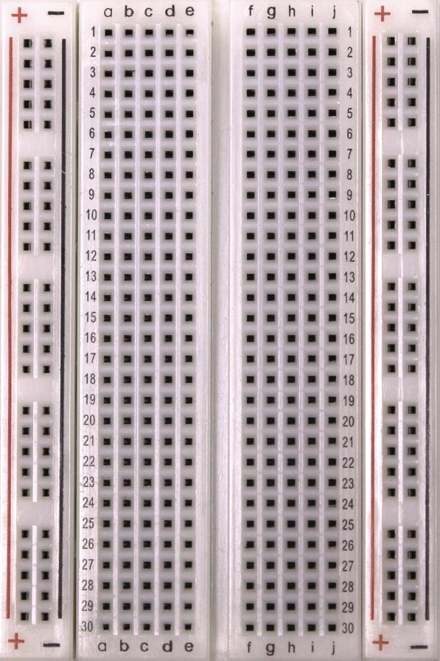
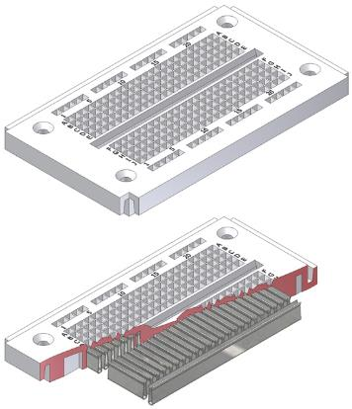
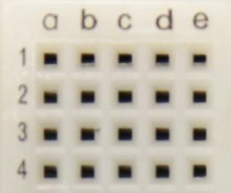
How a breadboard works
Component leads and wires are inserted into holes in the breadboard
Half-rows of five holes are connected
Vertical columns are connected for power/ground
Holes to
insert wires

Slide 21
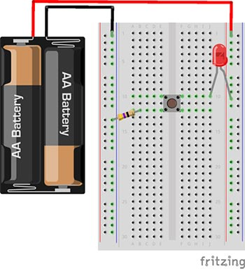
Breadboard LED example
Uses button to control LED

Slide 22
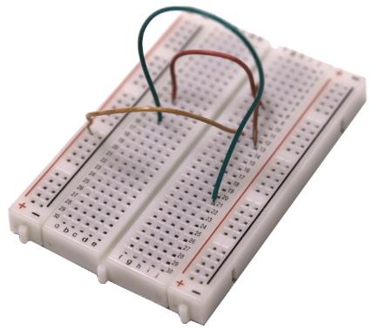
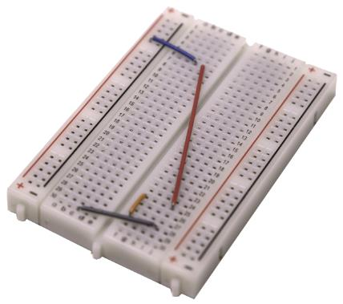
Breadboard guidelines
Long wires in large bird nests makes debugging very difficult
Shorter, constrained wires are easier to understand
In this class, we’ll only have large jumper wires though…
Use the minimum jumpers necessary, mostly use breadboard for connections
Bad
Better

Slide 23
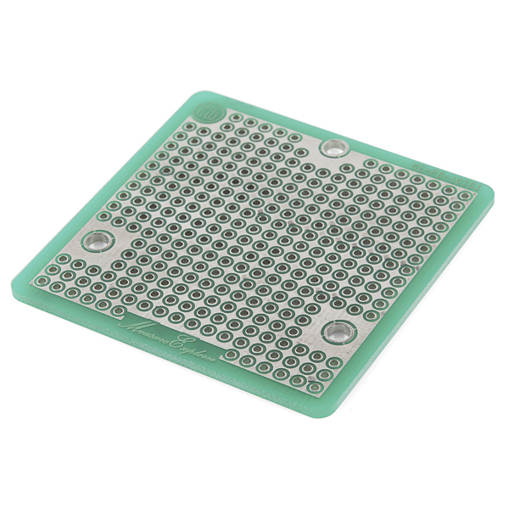
More permanent breadboards
Breadboards are also known as “Solderless Breadboards”
Protoboard allows configurable circuits
Solder jumper wires between locations
Solder adjacent pads to form connection
Usually not worth it (just make a PCB)
Does solve core problem of breadboards: things getting unintentionally unplugged
Might be useful for some projects!

Slide 24
When to not use breadboards
Breadboards work great for digital circuits and simple analog!
High voltage/current are bad for breadboards
Honestly, anything above 12 volts DC shouldn’t be in a breadboard
Also avoid high-power applications above a few Watts
Never put AC in a breadboard!
Sensitive analog circuits
Particularly anything sensitive to capacitance may not work right
Sets of metal holes with strips connecting them function as capacitors
Anything in long term use

Slide 25
Outline
DMA
Prototyping
Digital Circuits
Components

Slide 26
Digital signals
Exist in two states:
High (a.k.a. Set, a.k.a. 1)
Low (a.k.a. Clear, a.k.a. 0)
Simpler to interact with
Constrained to two voltages
With quick transitions between the two
No math for voltage level
Either high or low

Slide 27
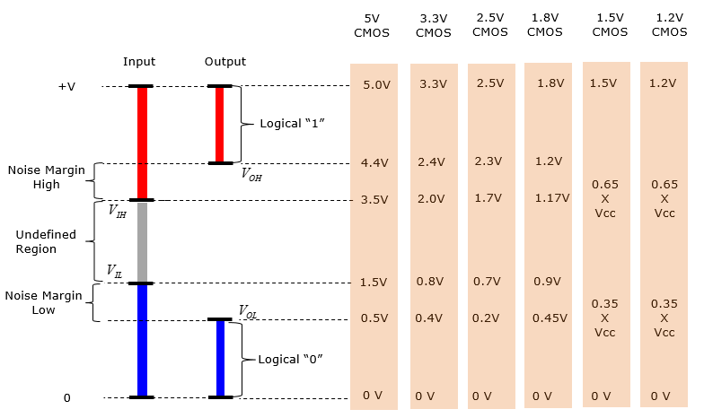
Digital signals map to voltage ranges
Upper range is high signal
~0.7*VDD
Bottom range is low signal
~0.3*VDD
Middle is undefined
Only exists during transitions
http://www.sharetechnote.com/html/Electronics_CMOS.html

Slide 28
Digital circuits
Connecting components together with digital signals
Mostly ICs
Also buttons/switches and LEDs
Way simpler than analog circuits
Mostly connecting boxes with wires
Plus a few resistors here and there
An abstraction
Not sufficient for fully understanding electronics behavior, but close

Slide 29
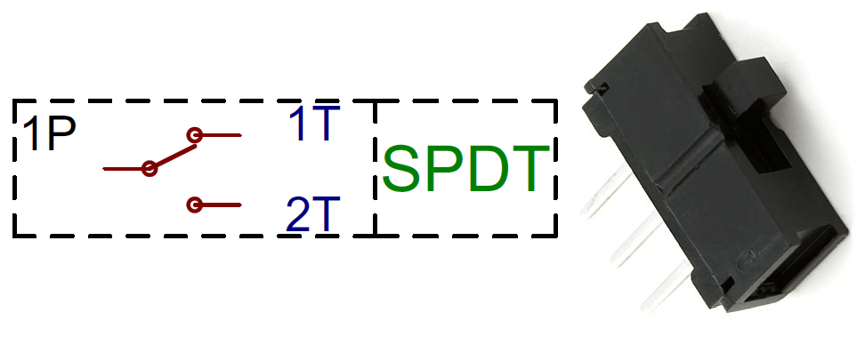
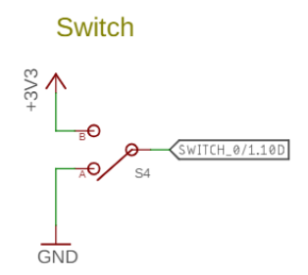
Switches
Single Pole, Double Throw switch
Middle pin (Pole) connects to one of two outer pins (Throws)
For controlling microcontrollers
Often connect outer pins to VCC and Ground respectively
Input then goes High or Low depending on switch state
https://learn.sparkfun.com/tutorials/button-and-switch-basics/

Slide 30
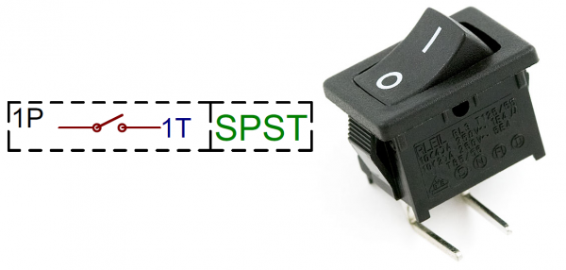
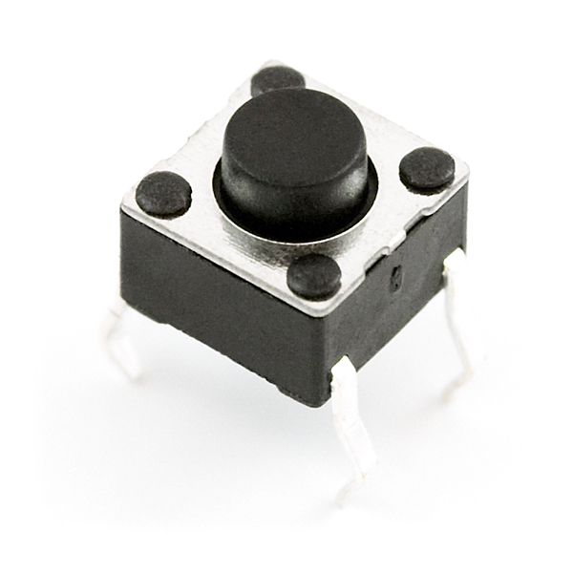
Buttons
Single Pole, Single Throw switch
Pole pin either connects to Throw pin or is disconnected
Come in normally-closed (connected) and normally-open (disconnected)

Slide 31
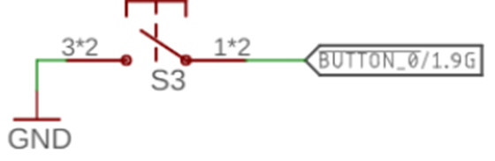
Disconnected circuits
When button is pushed, input signal is low
What is the value of the input when the button is unpressed?

Slide 32
Disconnected circuits
When button is pushed, input signal is low
What is the value of the input when the button is unpressed?
Floating! Could be any voltage
Solution: need to connect weakly to either high or low voltage

Slide 33
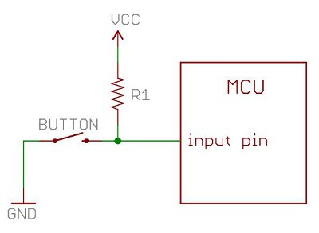
Current flows through the “path of least resistance”
Simplification
Works well for the types of circuits we use
Pull-up resistor
When button is open (disconnected), the only path is through the resistor
When button is closed (connected) the least resistance path is through the button to Ground

Slide 34
Pull-up resistors and pull-down resistors
Resistor sets the “default” value of a wire
Pull-up connects to VCC
Pull-down connects to Ground
Usually 10-100 kΩ
When button is open (disconnected)
Connection through the resistor sets signal
When button is closed (connected)
Signal is directly connected to a voltage source
Much lower resistance means that signal dominates

Slide 35
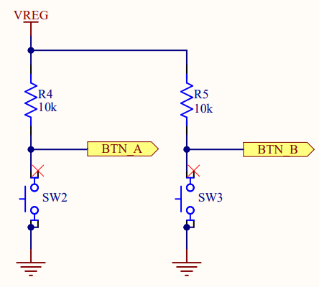
Buttons on the Microbit
Normally open buttons
Disconnected by default
Active low signal
Activating (pushing) button creates a low signal
Pull-up resistors
Set button signal high by default

Slide 36
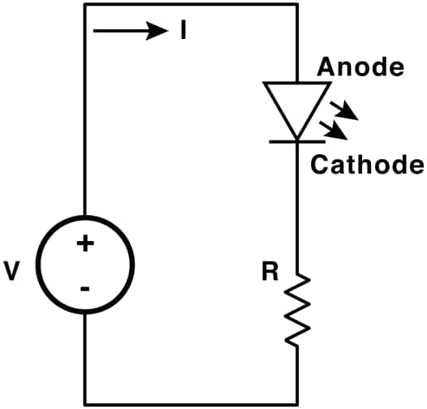
LEDs
Light Emitting Diodes
Generate light as current passes through them
Various colors available
Diodes
Only allow current to go through one way
Not particularly relevant for LEDs
Treat as a digital component
Connect anode to high voltage and cathode to ground
Plus a resistor to limit the total amount of current
https://learn.sparkfun.com/tutorials/light-emitting-diodes-leds

Slide 37
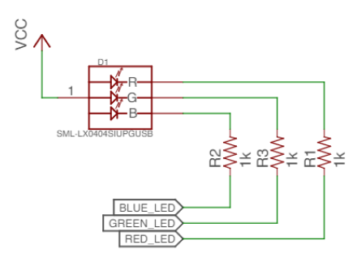
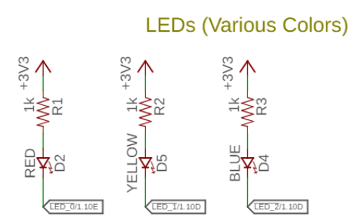
Active state for LEDs
LEDs can be active high or active low depending on configuration
Active high is how people assume they work
Active low is often used instead
GPIO pins can usually sink more current than they can source

Slide 38
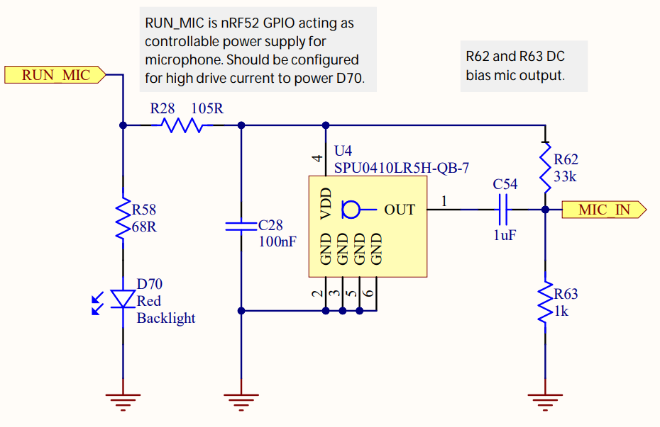
LEDs on the Microbit
Microphone LED
Active high
Simple to use, just set the GPIO high to enable it
Ignore this other part for now

Slide 39
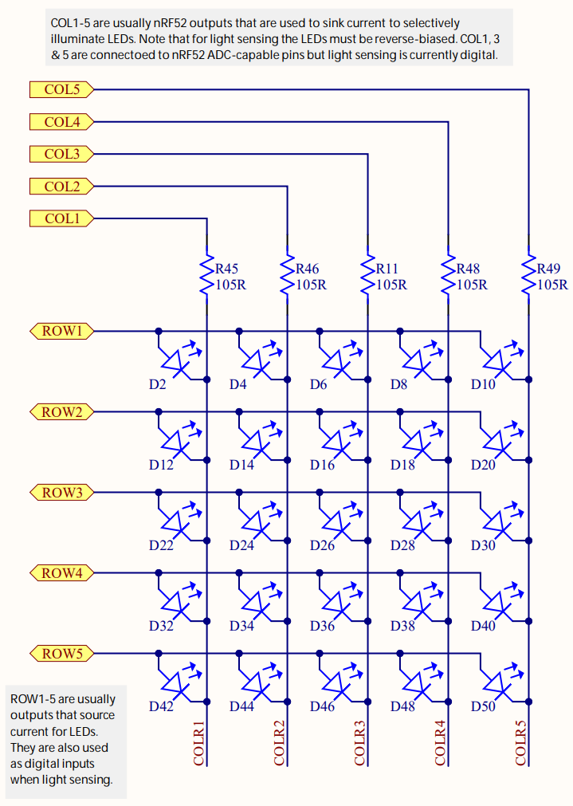
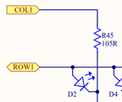
LEDs on the Microbit
Use two GPIO pins to control each LED
Row high as VDD
Column low as Ground
Remember, connections only exist where there are dots

Slide 40
Controlling the LED matrix
Cannot individually control all LEDs simultaneously
Need to light one row at a time
Iterate rows quickly to make them appear on all the time
We’ll have a lab on these later
Combines GPIO and timers

Slide 41
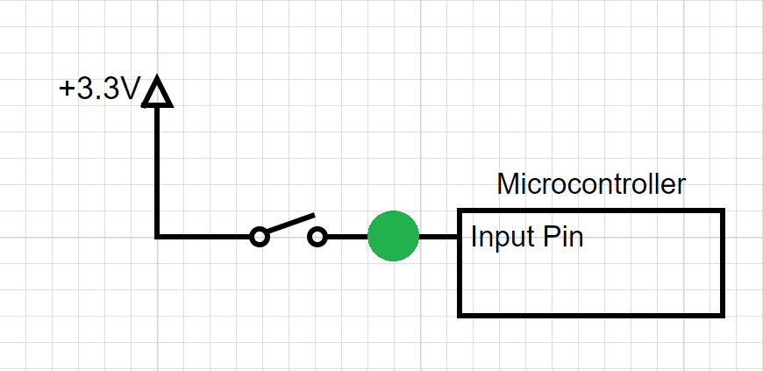
Break + Question
Should the spot in green have?
Pull-up Resistor
Pull-down Resistor
Either
Neither

Slide 42
Break + Question
Should the spot in green have?
Pull-up Resistor
Pull-down Resistor (needs to pull input low by default)
Either
Neither

Slide 43
Outline
DMA
Prototyping
Digital Circuits
Components

Slide 44
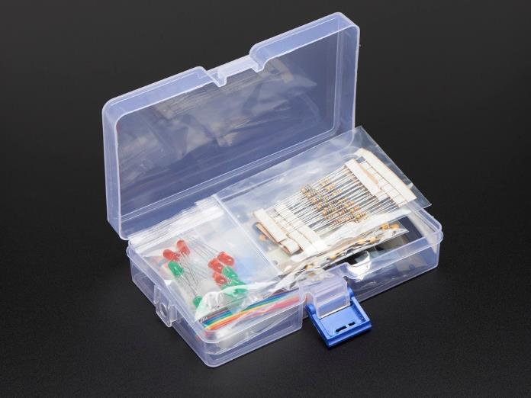
Prototyping with a breadboard
What kinds of things might you use with a breadboard?
Jumper wire
Microbit!
Resistors/Capacitors
LEDs
Buttons/Switches
Analog Sensors
Various other through-hole components
Transistors, Op-Amps, other ICs
https://www.adafruit.com/product/2975

Slide 45
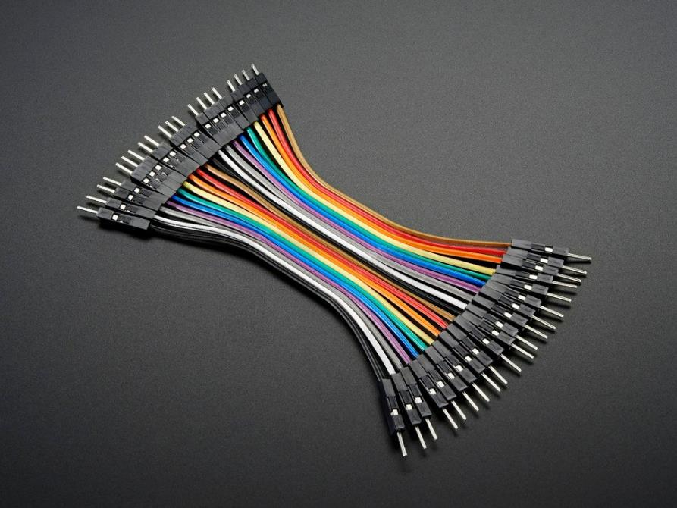
Jumper wires
Connect two rows in the breadboard together
Recommendation:
Peel off sets of 2-4 wires and keep them stuck together
Often want to run multiple at once

Slide 46
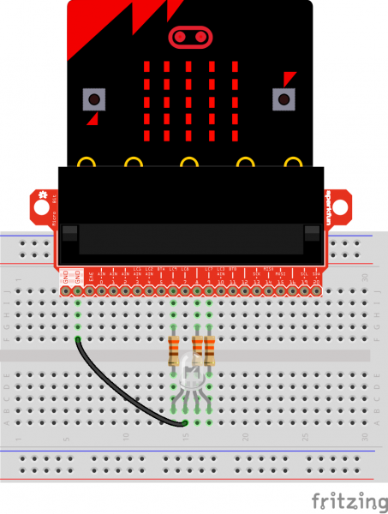
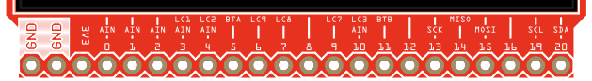
Microbit
Always connect LED matrix side up
Breaks out various pins from board
Need to consult table to know which pins
https://tech.microbit.org/hardware/schematic/
https://www.sparkfun.com/products/13989
https://learn.sparkfun.com/tutorials/microbit-breakout-board-hookup-guide

Slide 47
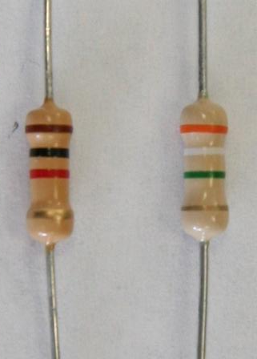
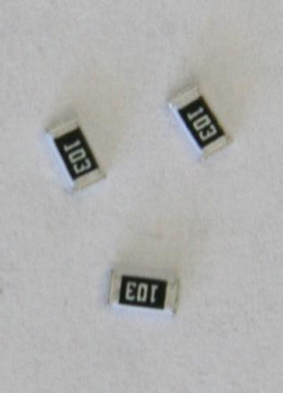
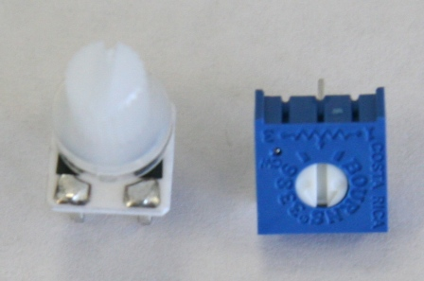

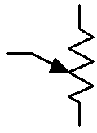
Resistors
Carbon Film Resistors
Surface Mount Resistors
Variable Resistors
(potentiometer)
4 Bands

Slide 48
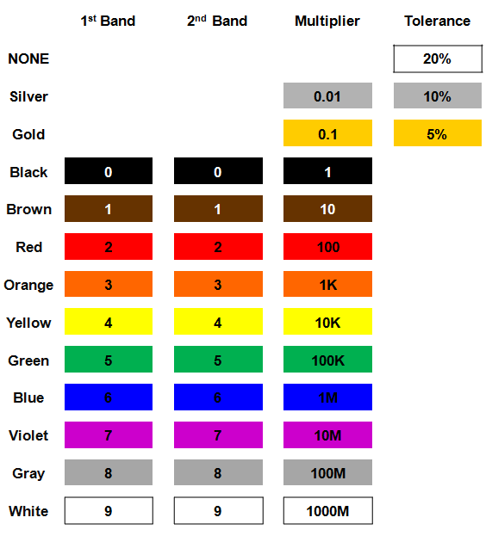
Resistor color codes
Colored bands on resistors label the resistance value of the part
First and second bands are the digits
Third band is multiplier
Fourth band is tolerance
Usually gold: +/- 5%

Slide 49
Example: determine the resistor

Slide 50
Example: determine the resistor
56 x 10 Ω = 560 Ω (±5%)

Slide 51
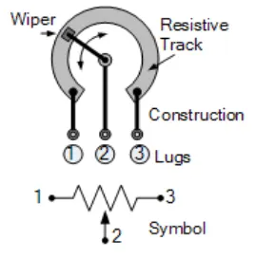
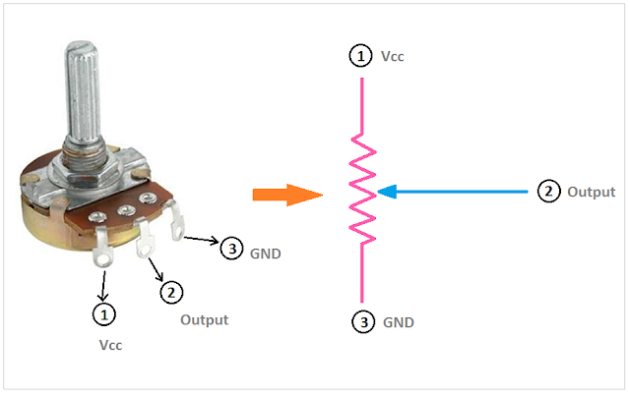
Potentiometers
Vary resistance between zero and some maximum
1 kΩ, 10 kΩ, 100 kΩ common
Connect middle and an edge for just a changeable resistor
Middle terminal is a movable resistor divider
Knob changes middle output if outer pins are VCC and Ground

Slide 52
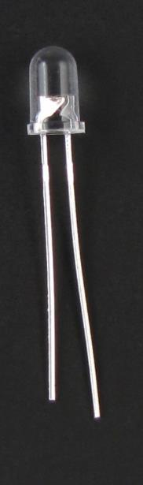
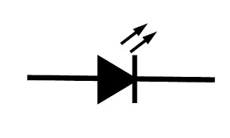
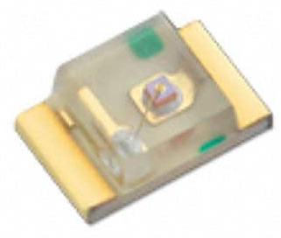
LEDs
Directional component: only allows current to flow one way
Shorter side is the negative one
i.e. where current flows to
Larger metal component
inside of case or case flat spot is cathode or
negative (-) lead
Negative ( - ) lead
Schematic Symbol
Shorter wire is cathode or
negative (-) lead
Surface-mount LED

Slide 53
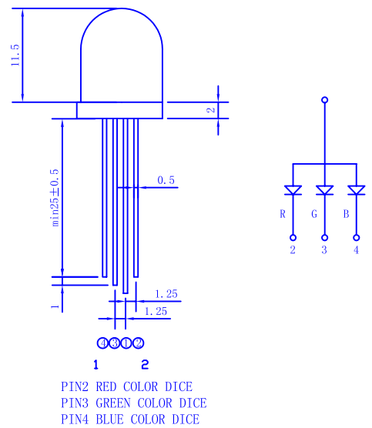
RGB LED
Three different colors of LED in a single large diffuser
Short leads are negative ends
One for each color
Long lead is common power
Common anode
Combinations of LEDs give other colors
Cyan, Yellow, Violet, White
https://cdn-shop.adafruit.com/datasheets/FLR-100WAS-RGB.pdf

Slide 54
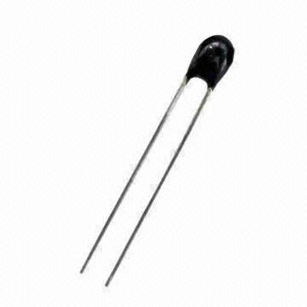
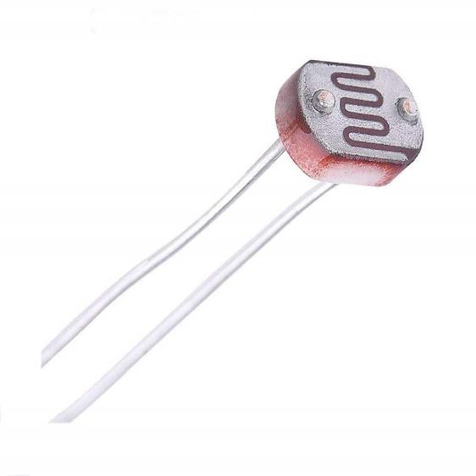
Sensors
Thermistor
Photoresistor
We’ll come back to these in a future lecture

Slide 55
Outline
DMA
Prototyping
Digital Circuits
Components

